Slide 1

Shopping Cart Project
Aniket Giriyalkar (giriyalkar.aniket@gmail.com)
GitHub Repo: https://github.com/aniketgiriyalkar/ShoppingCart

Slide 2
Features Implemented
Slider and Input – to filter the product list based on the Price.
Toggle controlled Slider which appears and disappears on selecting.
Checkout Page (Add and remove items from the selected items).
Remove selected products from the Cart dropdown.
Readme File with detailed documentation: https://github.com/aniketgiriyalkar/ShoppingCart/blob/main/README.md

Slide 3
Slider and Input
Filters the product list based on the price selected. All the products having a cost of <= Product Cost.
Moving the slider changes the value in the Input box and manually typing the value changes the position in the slider.
This can be toggled on or off by clicking on the $ icon
Toggle ON version
Toggle OFF version(hides the Input and Slider)

Slide 4
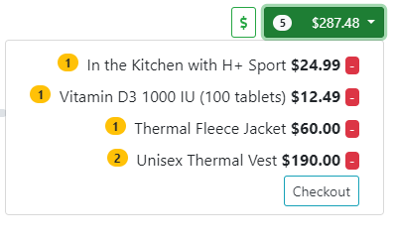
Cart Dropdown
Consists of the products that are added to the cart.
If a product is selected multiple times, its quantity is incremented which appears to the left of the product name.
One can remove the items selected by pressing on the red [–] button.
A link to the Checkout page is also available from here.

Slide 5
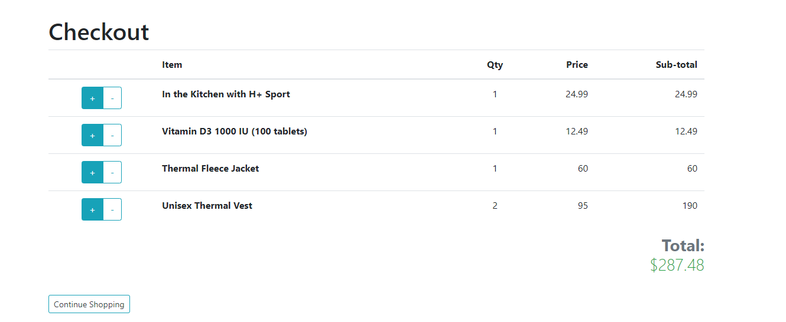
Checkout Page
We can see a well formatted Checkout page indicating the products selected, their quantity and their subtotal. Cart total is also evaluated.
A link to the home page is made available using the vue-router by providing a Continue Shopping button.

Slide 6
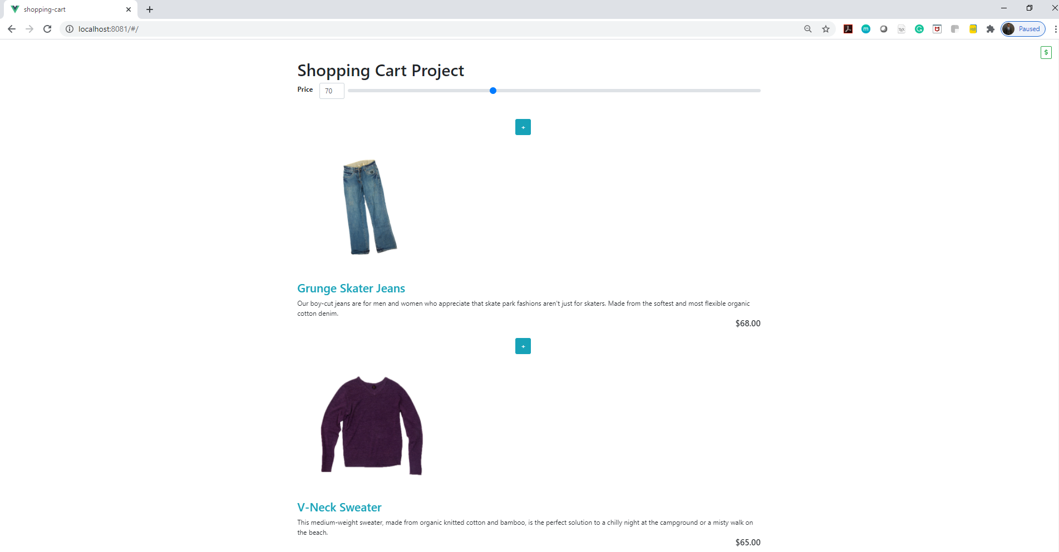
Home Page
Supports styling and transitions imported from bootstrap classes

Slide 7




Video Demo
Working of all the features is shown in the following Video slide.

Slide 8
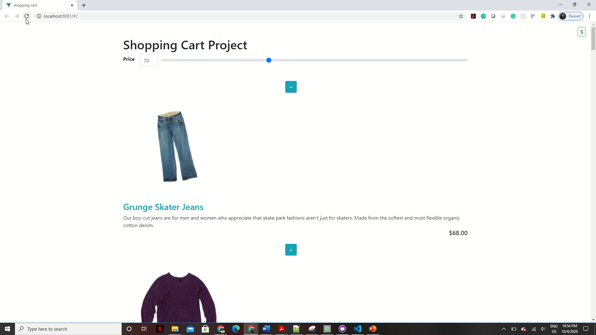

Slide 9
Thank You!!!
Pointers
Installed Vue.js and Understood Vue CLI installations
Created a reactive application
Worked with bootstrap classes for transitions and animations
Toggled elements with a key
Added navigation
Fetched data from an API
Built routes and created route links

